Slide 1
Nature Inspired CNNs Optimization

Slide 2
Team
Group members:
15140094 Mohsin Ashraf
14140062 Mushood Hanif
15140107 Mehvish Hameed
14140044 Rida Yaqoob
Supervisor:
Syed Qamar Askari

Slide 3
Overview
Problem Statement
CNNs
Evolutionary Algorithms
Literature Review
Description
Our Work
Benchmarks
References
Scope
Work-breakdown Structure
Learning outcomes

Slide 4
Problem Statement
Automation of CNN initialization for any given dataset with an optimal architecture for best results.

Slide 5
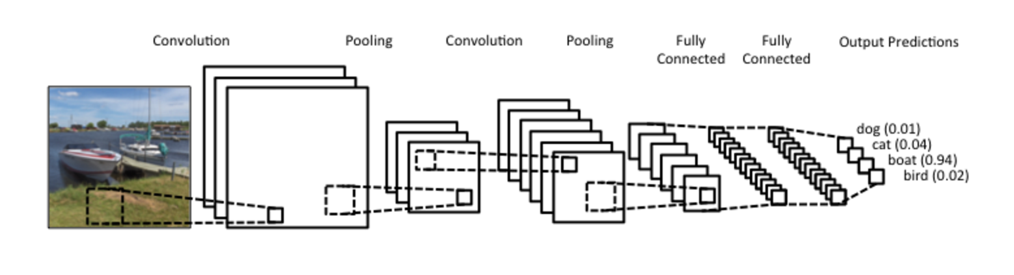
Convolutional Neural Networks
Deep Learning Network
Inspired by Humans

Slide 6
Evolutionary Algorithms
A process resulting in the improvement of a species over the span of a few generations by adapting and learning from the environment.

Slide 7
Literature Review Description
Paper | Work
ImageNet | Using CNNs on Big Data
Efficient Parallel Learning Algorithms for Neural Networks | Parallelizable techniques applied to learning in Neural Networks
Genetic Programming Approach to Designing Neural Network Architectures | Using Cartesian Genetic Programming to encode and generate optimal architectures.
Large scale evolution of convolutional neural networks using volunteer computing. | Evolving a given architecture and evolving it until optimal results arise using a genetic algorithm.
Evolving Deep Convolutional Neural Networks by Variable-length Particle Swarm Optimization for Image Classification. | Using Particle swarm optimization with an IP-inspired encoding strategy to find an optimal architecture for a given dataset.

Slide 8
Our Work
Hybrid Approach Combining All Previously Mentioned Approaches
Provided a UI for Ease of Access to Users and Better Usability
Improving efficiency by Parallelizing the CNN Evaluation Process
Compare and Contrast
Difference in the Parameters Handled
Addition of an interface for users
Parallel working efficiency

Slide 9
Benchmarks
Benchmark Dataset | Neural Net Type | Results (Error Rates)
CIFAR-10 | ResNet | 6.61%
 | MetaQNN | 9.09%

Slide 10
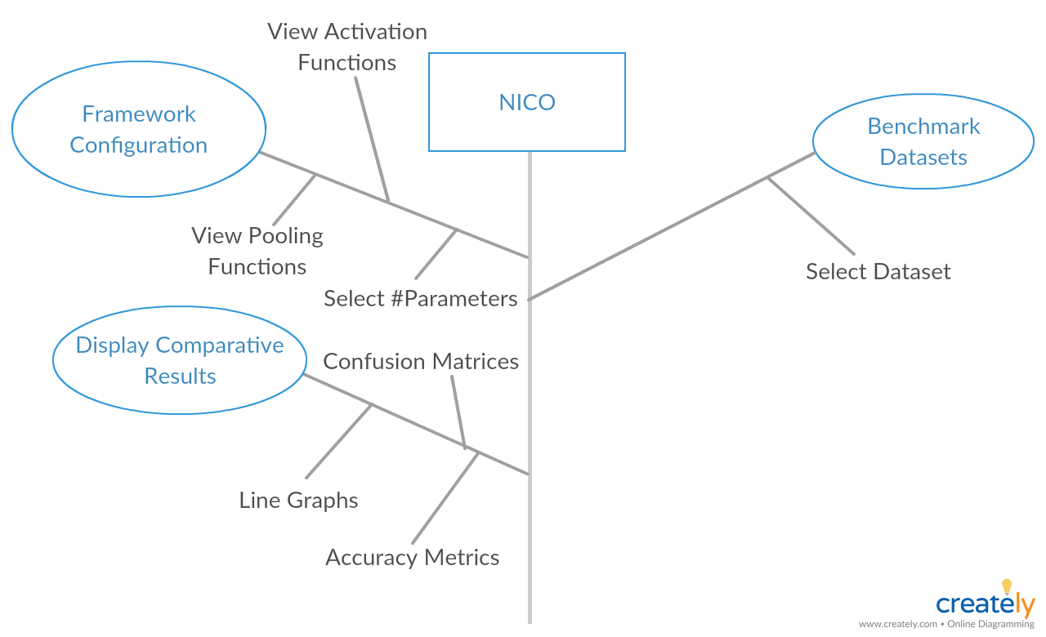

Slide 11
Learning Outcomes
Research & Development
Exposure to deep learning
Exposure to evolutionary algorithms

